Slide 1

Online BookStore system
By:
Anusha Hosamani
Hima Thirumulswamy
Prathiksha Nataraja
Shirisha Jujare

Slide 2

Abstract
Online Book store is an online web application where the customer can purchase books online. where the user can search the book ,later can add to shopping cart and finally purchase the books.

Slide 3

PROBLEM STATEMENT
The design and implement an online bookstore. In the Bookstore customer searches for his required book and purchases them. This process requires every aspect (customer, book, money).

Slide 4
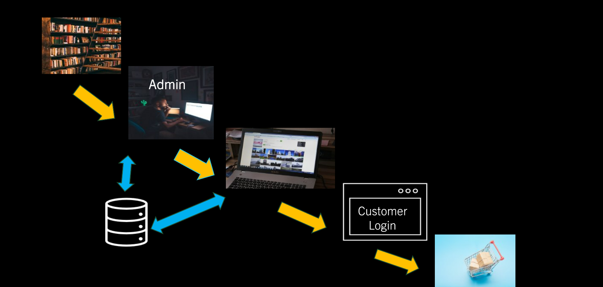
System Architecture

Slide 5
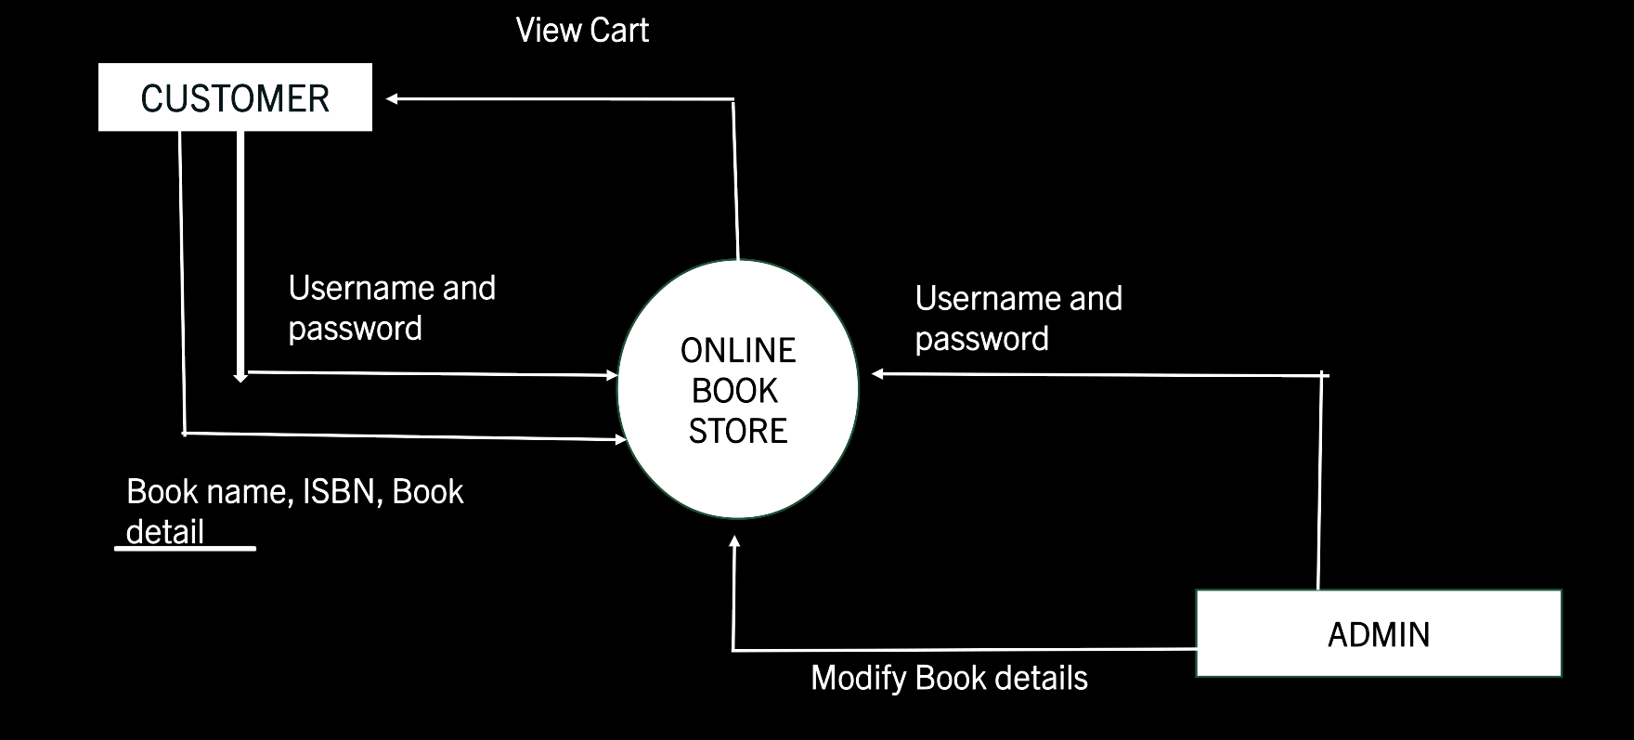
FLOW diagram

Slide 6
Technologies used
Spring Boot Framework
Spring MVC
Database-HeidiSQL
Java
HTML & CSS

Slide 7
Modules
User Registration
Book Details Entry
Search Book
View Book
Add to cart
Payments

Slide 8
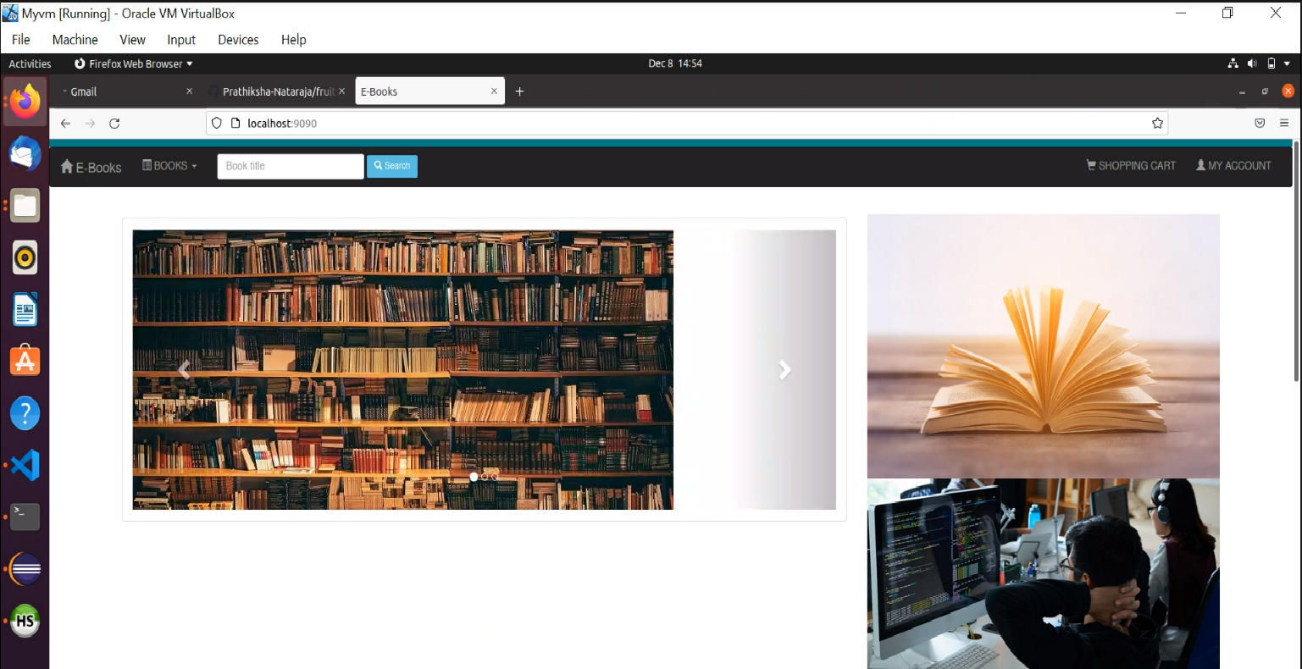
SCREEN SHOOTS
This Photo by Unknown author is licensed under CC BY-NC-ND.

Slide 9
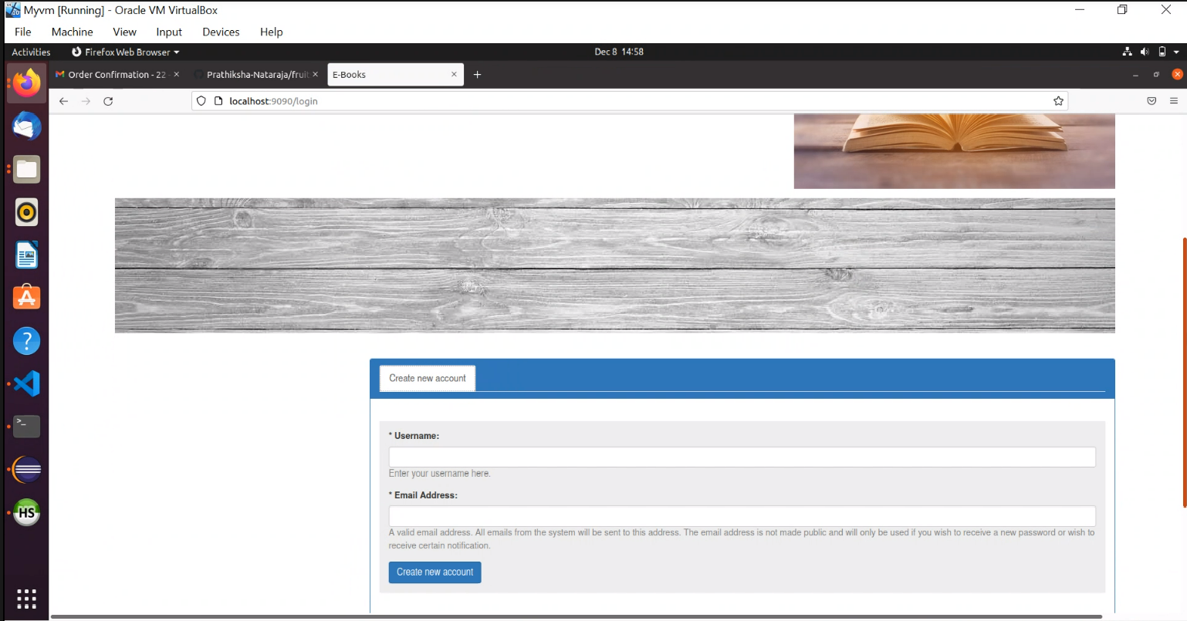
SCREEN SHOOTS
This Photo by Unknown author is licensed under CC BY-NC-ND.

Slide 10
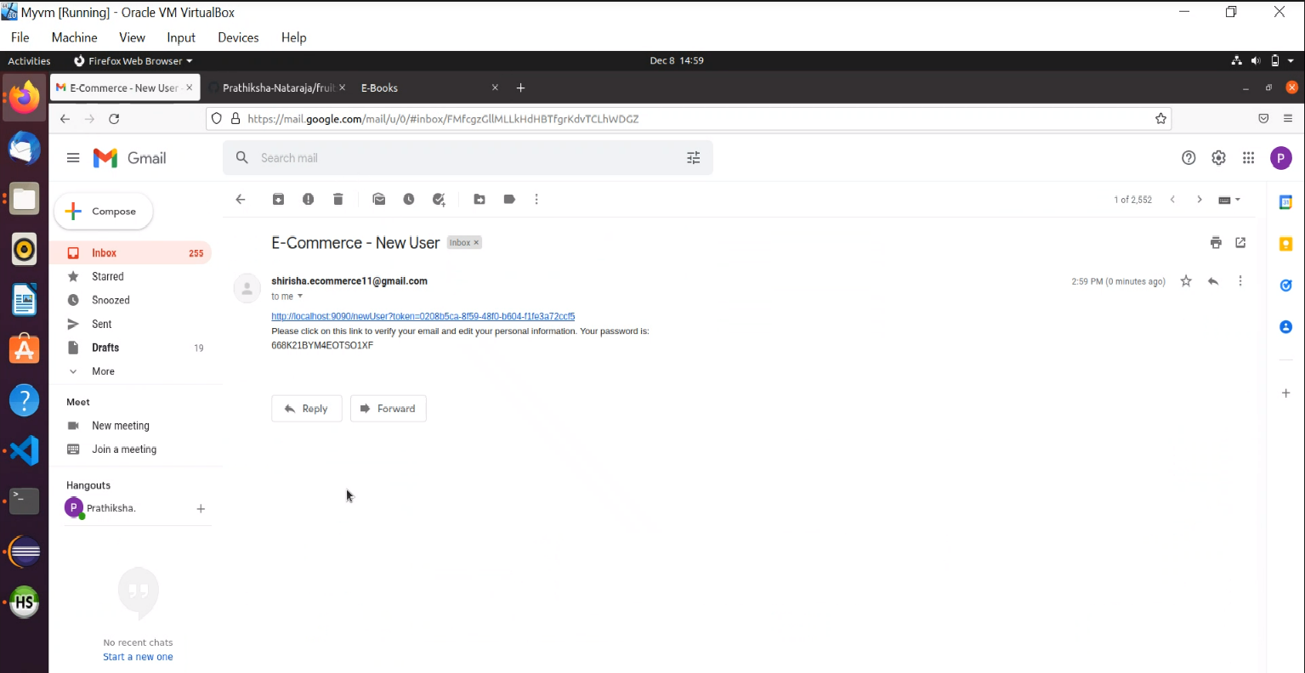
SCREEN SHOOTS
This Photo by Unknown author is licensed under CC BY-NC-ND.

Slide 11
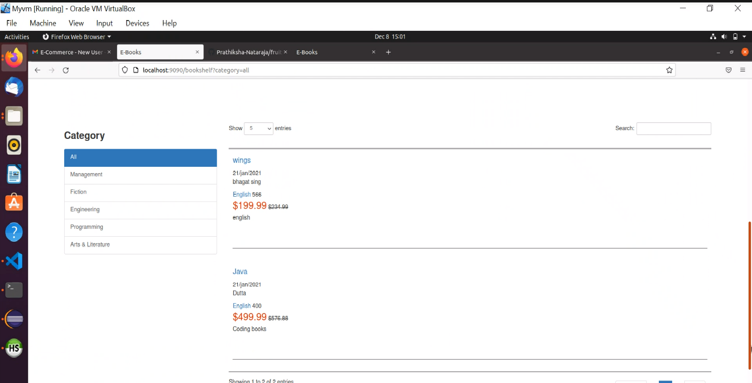
SCREEN SHOOTS
This Photo by Unknown author is licensed under CC BY-NC-ND.

Slide 12
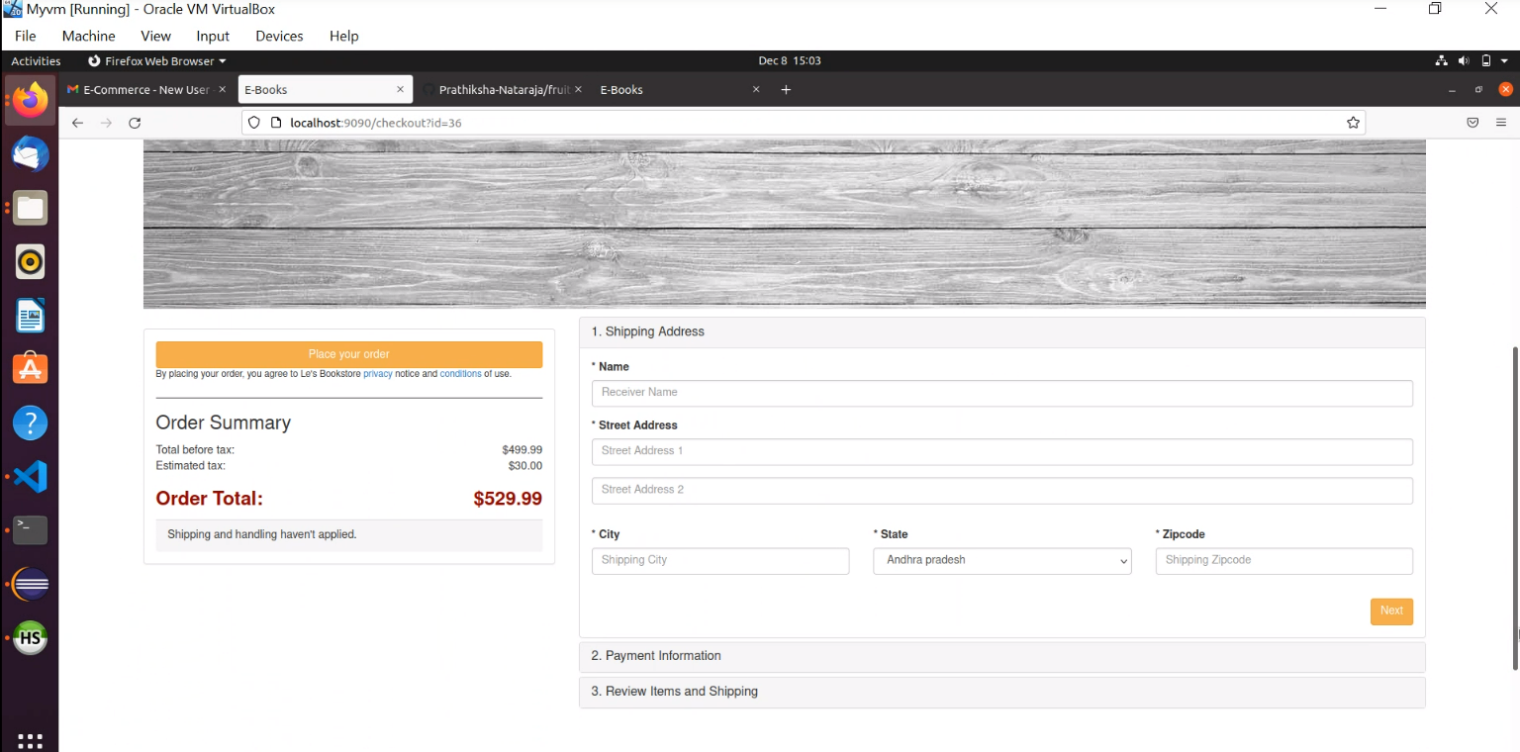
SCREEN SHOOTS
This Photo by Unknown author is licensed under CC BY-NC-ND.

Slide 13
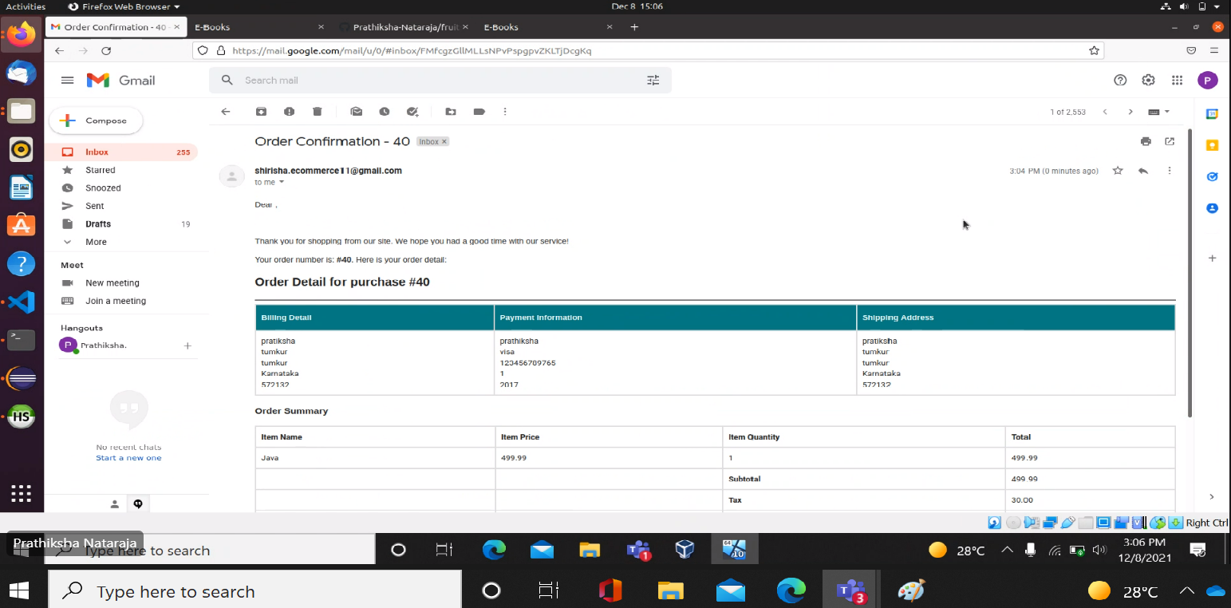
SCREEN SHOOTS
This Photo by Unknown author is licensed under CC BY-NC-ND.

